Slide 1
The Data Link Layer
Chapter 3

Slide 2
Data Link Layer Design Issues
Network layer services
Framing
Error control
Flow control

Slide 3
Data Link Layer
Algorithms for achieving:
  Reliable, +
  Efficient,
  communication of a whole units – frames (as opposed to bits – Physical Layer) between two machines.
Two machines are connected by a communication channel that acts conceptually like a wire (e.g., telephone line, coaxial cable, or wireless channel).
Essential property of a channel that makes it “wire-like” connection is that the bits are delivered in exactly the same order in which they are sent.

Slide 4
Data Link Layer
For ideal channel (no distortion, unlimited bandwidth and no delay) the job of data link layer would be trivial.
However, limited bandwidth, distortions and delay makes this job very difficult.

Slide 5
Data Link Layer Design Issues
Physical layer delivers bits of information to and from data link layer. The functions of Data Link Layer are:
  Providing a well-defined service interface to the network layer.
  Dealing with transmission errors.
  Regulating the flow of data so that slow receivers are not swamped by fast senders.
Data Link layer
  Takes the packets from Physical layer, and
  Encapsulates them into frames

Slide 6
Data Link Layer Design Issues
Each frame has a
  frame header – a field for holding the packet, and
  frame trailer.
Frame Management is what Data Link Layer does.
See figure in the next slide:

Slide 7
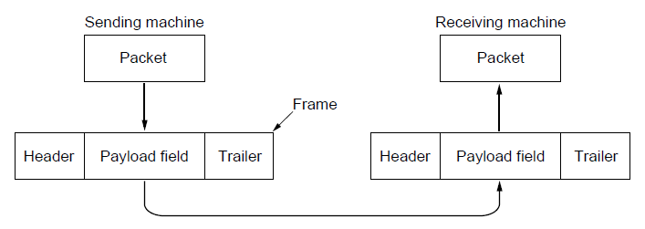
Packets and Frames
Relationship between packets and frames.

Slide 8
Services Provided to the Network Layer
Principal Service Function of the data link layer is to transfer the data from the network layer on the source machine to the network layer on the destination machine.
  Process in the network layer that hands some bits to the data link layer for transmission.
  Job of data link layer is to transmit the bits to the destination machine so they can be handed over to the network layer there (see figure in the next slide).

Slide 9
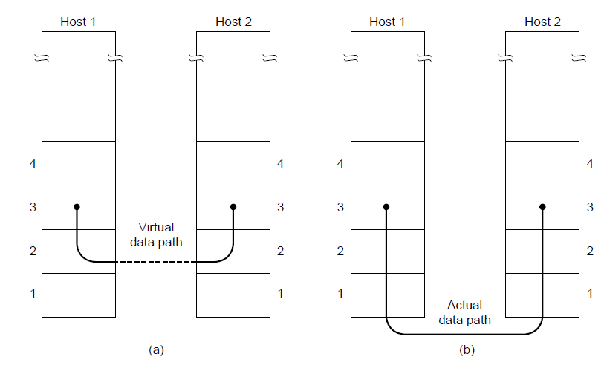
Network Layer Services
(a) Virtual communication. (b) Actual communication.

Slide 10
Possible Services Offered
Unacknowledged connectionless service.
Acknowledged connectionless service.
Acknowledged connection-oriented service.

Slide 11
Unacknowledged Connectionless Service
It consists of having the source machine send independent frames to the destination machine without having the destination machine acknowledge them.
Example: Ethernet, Voice over IP, etc. in all the communication channel were real time operation is more important that quality of transmission.

Slide 12
Acknowledged Connectionless Service
Each frame send by the Data Link layer is acknowledged and the sender knows if a specific frame has been received or lost.
Typically the protocol uses a specific time period that if has passed without getting acknowledgment it will re-send the frame.
This service is useful for commutation when an unreliable channel is being utilized (e.g., 802.11 WiFi).
Network layer does not know frame size of the packets and other restriction of the data link layer. Hence it becomes necessary for data link layer to have some mechanism to optimize the transmission.

Slide 13
Acknowledged Connection Oriented Service
Source and Destination establish a connection first.
Each frame sent is numbered
  Data link layer guarantees that each frame sent is indeed received.
  It guarantees that each frame is received only once and that all frames are received in the correct order.
Examples:
  Satellite channel communication,
  Long-distance telephone communication, etc.

Slide 14
Acknowledged Connection Oriented Service
Three distinct phases:
  Connection is established by having both side initialize variables and counters needed to keep track of which frames have been received and which ones have not.
  One or more frames are transmitted.
  Finally, the connection is released – freeing up the variables, buffers, and other resources used to maintain the connection.

Slide 15
Framing
To provide service to the network layer the data link layer must use the service provided to it by physical layer.
Stream of data bits provided to data link layer is not guaranteed to be without errors.
Errors could be:
  Number of received bits does not match number of transmitted bits (deletion or insertion)
  Bit Value
It is up to data link layer to correct the errors if necessary.

Slide 16
Framing
Transmission of the data link layer starts with breaking up the bit stream
  into discrete frames
  Computation of a checksum for each frame, and
  Include the checksum into the frame before it is transmitted.
Receiver computes its checksum error for a receiving frame and if it is different from the checksum that is being transmitted will have to deal with the error.
Framing is more difficult than one could think!

Slide 17
Framing Methods
Byte count.
Flag bytes with byte stuffing.
Flag bits with bit stuffing.
Physical layer coding violations.

Slide 18
Byte Count Framing Method
It uses a field in the header to specify the number of bytes in the frame.
Once the header information is being received it will be used to determine end of the frame.
See figure in the next slide:
Trouble with this algorithm is that when the count is incorrectly received the destination will get out of synch with transmission.
  Destination may be able to detect that the frame is in error but it does not have a means (in this algorithm) how to correct it.

Slide 19
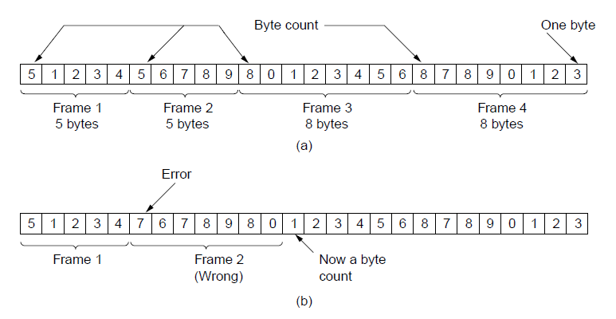
Framing (1)
A byte stream. (a) Without errors. (b) With one error.

Slide 20
Flag Bytes with Byte Staffing Framing Method
This methods gets around the boundary detection of the frame by having each appended by the frame start and frame end special bytes.
If they are the same (beginning and ending byte in the frame) they are called flag byte.
In the next slide figure this byte is shown as FLAG.
If the actual data contains a byte that is identical to the FLAG byte (e.g., picture, data stream, etc.) the convention that can be used is to have escape character inserted just before the “FLAG” character.

Slide 21
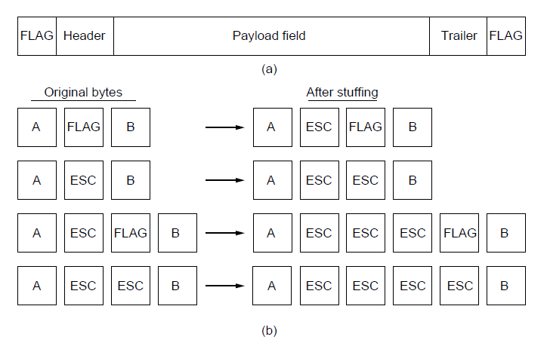
Framing (2)
A frame delimited by flag bytes.
Four examples of byte sequences before and after byte stuffing.

Slide 22
Flag Bits with Bit Stuffing Framing Method
This methods achieves the same thing as Byte Stuffing method by using Bits (1) instead of Bytes (8 Bits).
It was developed for High-level Data Link Control (HDLC) protocol.
Each frames begins and ends with a special bit patter:
  01111110 or 0x7E <- Flag Byte
  Whenever the sender’s data link layer encounters five consecutive 1s in the data it automatically stuffs a 0 bit into the outgoing bit stream.
  USB uses bit stuffing.

Slide 23
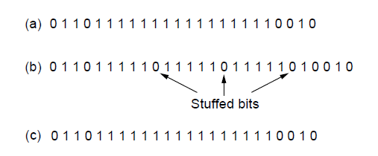
Framing (3)
Bit stuffing. (a) The original data. (b) The data as they appear on
the line. (c) The data as they are stored in the receiver’s memory after destuffing.

Slide 24
Framing
Many data link protocols use a combination of presented methods for safety. For example in Ethernet and 802.11 each frame begin with a well-defined pattern called a preamble.
Preamble is typically 72 bits long.
It is then followed by a length fileld.

Slide 25
Error Control
After solving the marking of the frame with start and end the data link layer has to handle eventual errors in transmission or detection.
  Ensuring that all frames are delivered to the network layer at the destination and in proper order.
Unacknowledged connectionless service: it is OK for the sender to output frames regardless of its reception.
Reliable connection-oriented service: it is NOT OK.

Slide 26
Error Control
Reliable connection-oriented service usually will provide a sender with some feedback about what is happening at the other end of the line.
  Receiver Sends Back Special Control Frames.
  If the Sender Receives positive Acknowledgment it will know that the frame has arrived safely.
Timer and Frame Sequence Number for the Sender is Necessary to handle the case when there is no response (positive or negative) from the Receiver .

Slide 27
Flow Control
Important Design issue for the cases when the sender is running on a fast powerful computer and receiver is running on a slow low-end machine.
Two approaches:
  Feedback-based flow control
  Rate-based flow control

Slide 28
Feedback-based Flow Control
Receiver sends back information to the sender giving it permission to send more data, or
Telling sender how receiver is doing.

Slide 29
Rate-based Flow Control
Built in mechanism that limits the rate at which sender may transmit data, without the need for feedback from the receiver.

Slide 30
Error Detection and Correction
Two basic strategies to deal with errors:
  Include enough redundant information to enable the receiver to deduce what the transmitted data must have been.
  Error correcting codes.
  Include only enough redundancy to allow the receiver to deduce that an error has occurred (but not which error).
  Error detecting codes.

Slide 31
Error Detection and Correction
Error codes are examined in Link Layer because this is the first place that we have run up against the problem of reliability transmitting groups of bits.
  Codes are reused because reliability is an overall concern.
  The error correcting code are also seen in the physical layer for noise channels.
  Commonly they are used in link, network and transport layer.

Slide 32
Error Detection and Correction
Error codes have been developed after long fundamental research conducted in mathematics.
Many protocol standards get codes from the large field in mathematics.

Slide 33
Error Detection & Correction Code (1)
Hamming codes.
Binary convolutional codes.
Reed-Solomon codes.
Low-Density Parity Check codes.

Slide 34
Error Detection & Correction Code
All the codes presented in previous slide add redundancy to the information that is being sent.
A frame consists of
  m data bits (message) and
  r redundant bits (check).
Block code - the r check bits are computed solely as function of the m data bits with which they are associated.
Systemic code – the m data bits are send directly along with the check bits.
Linear code – the r check bits are computed as a linear function of the m data bits.

Slide 35
Error Detection & Correction Code
n – total length of a block (i.e., n = m + r)
(n, m) – code
n – bit codeword containing n bits.
m/n – code rate (range ½ for noisy channel and close to 1 for high-quality channel).

Slide 36
Error Detection & Correction Code
Example
Transmitted: 10001001
Received: 10110001
XOR operation gives number of bits that are different.
XOR: 00111000
Number of bit positions in which two codewords differ is called Hamming Distance. It shows that two codes are d distance apart, and it will require d errors to convert one into the other.

Slide 37
Error Detection & Correction Code
All 2^{m} possible data messages are legal, but due to the way the check bits are computers not all 2^{n} possible code words are used.
Only small fraction of 2^{m}/2^{n}=1/2^{r} are possible will be legal codewords.
The error-detecting and error-correcting codes of the block code depend on this Hamming distance.
To reliably detect d error, one would need a distance d+1 code.
To correct d error, one would need a distance 2d+1 code.

Slide 38
Error Detection & Correction Code
All 2^{m} possible data messages are legal, but due to the way the check bits are computers not all 2^{n} possible code words are used.
Only small fraction of 2^{m}/2^{n}=1/2^{r} are possible will be legal codewords.
The error-detecting and error-correcting codes of the block code depend on this Hamming distance.
To reliably detect d error, one would need a distance d+1 code.
To correct d error, one would need a distance 2d+1 code.

Slide 39
Error Detection & Correction Code
Example:
4 valid codes:
  0000000000
  0000011111
  1111100000
  1111111111
Minimal Distance of this code is 5 => can correct and double errors and it detect quadruple errors.
0000000111 => single or double – bit error. Hence the receiving end must assume the original transmission was 0000011111.
0000000000 => had triple error that was received as 0000000111 it would be detected in error.

Slide 40
Error Detection & Correction Code
One cannot perform double errors and at the same time detect quadruple errors.
Error correction requires evaluation of each candidate codeword which may be time consuming search.
Through design this search time can be minimized.
In theory if n = m + r, this requirement becomes:
  (m + r + 1) ≤ 2^{r}

Slide 41
Hamming Code
Codeword: b1 b2 b3 b4 ….
Check bits: The bits that are powers of 2 (p1, p2, p4, p8, p16, …).
The rest of bits (m3, m5, m6, m7, m9, …) are filled with m data bits.
Example of the Hamming code with m = 7 data bits and r = 4 check bits is given in the next slide.

Slide 42
The Hamming Code
Consider a message having four data bits (D) which is to be transmitted as a 7-bit codeword by adding three error control bits. This would be called a (7,4) code. The three bits to be added are three EVEN Parity bits (P), where the parity of each is computed on different subsets of the message bits as shown below.
7 | 6 | 5 | 4 | 3 | 2 | 1
D | D | D | P | D | P | P | 7-BIT CODEWORD
D | - | D | - | D | - | P | (EVEN PARITY)
D | D | - | - | D | P | - | (EVEN PARITY)
D | D | D | P | - | - | - | (EVEN PARITY)

Slide 43
Hamming Code
Why Those Bits? - The three parity bits (1,2,4) are related to the data bits (3,5,6,7) as shown at right. In this diagram, each overlapping circle corresponds to one parity bit and defines the four bits contributing to that parity computation. For example, data bit 3 contributes to parity bits 1 and 2. Each circle (parity bit) encompasses a total of four bits, and each circle must have EVEN parity. Given four data bits, the three parity bits can easily be chosen to ensure this condition.
It can be observed that changing any one bit numbered 1..7 uniquely affects the three parity bits. Changing bit 7 affects all three parity bits, while an error in bit 6 affects only parity bits 2 and 4, and an error in a parity bit affects only that bit. The location of any single bit error is determined directly upon checking the three parity circles.

Slide 44
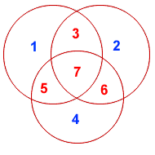
Hamming Code

Slide 45
Hamming Code
For example, the message 1101 would be sent as 1100110, since:
7 | 6 | 5 | 4 | 3 | 2 | 1
1 | 1 | 0 | 0 | 1 | 1 | 0 | 7-BIT CODEWORD
1 | - | 0 | - | 1 | - | 0 | (EVEN PARITY)
1 | 1 | - | - | 1 | 1 | - | (EVEN PARITY)
1 | 1 | 0 | 0 | - | - | - | (EVEN PARITY)

Slide 46
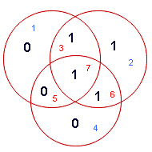
Hamming Codes
When these seven bits are entered into the parity circles, it can be confirmed that the choice of these three parity bits ensures that the parity within each circle is EVEN, as shown here.

Slide 47
Hamming Code
It may now be observed that if an error occurs in any of the seven bits, that error will affect different combinations of the three parity bits depending on the bit position.
For example, suppose the above message 1100110 is sent and a single bit error occurs such that the codeword 1110110 is received:
transmitted message received message
1 1 0 0 1 1 0 ------------> 1 1 1 0 1 1 0
BIT: 7 6 5 4 3 2 1 BIT: 7 6 5 4 3 2 1
The above error (in bit 5) can be corrected by examining which of the three parity bits was affected by the bad bit:

Slide 48
Hamming Code
7 | 6 | 5 | 4 | 3 | 2 | 1
1 | 1 | 1 | 0 | 1 | 1 | 0 | 7-BIT CODEWORD
1 | - | 1 | - | 1 | - | 0 | (EVEN PARITY) | NOT! | 1
1 | 1 | - | - | 1 | 1 | - | (EVEN PARITY) | OK! | 0
1 | 1 | 1 | 0 | - | - | - | (EVEN PARITY) | NOT! | 1

Slide 49
Hamming Code
In fact, the bad parity bits labeled 101 point directly to the bad bit since 101 binary equals 5. Examination of the 'parity circles' confirms that any single bit error could be corrected in this way.
The value of the Hamming code can be summarized:
Detection of 2 bit errors (assuming no correction is attempted);
Correction of single bit errors;
Cost of 3 bits added to a 4-bit message.
The ability to correct single bit errors comes at a cost which is less than sending the entire message twice. (Recall that simply sending a message twice accomplishes no error correction.)

Slide 50
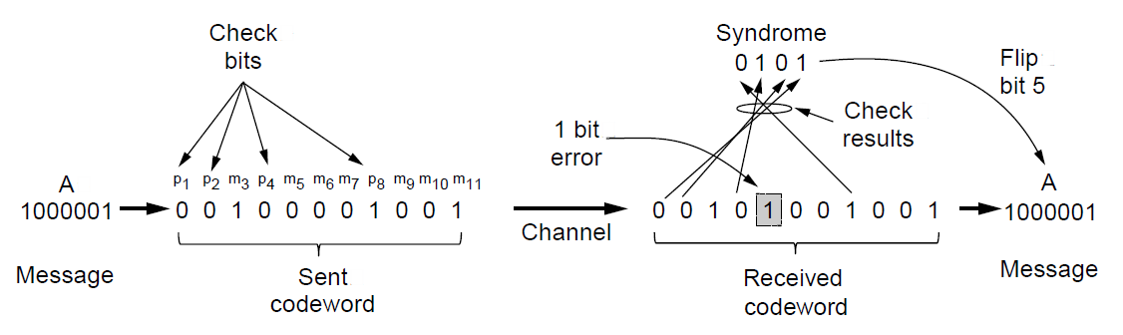
Error Detection Codes (2)
Example of an (11, 7) Hamming code
correcting a single-bit error.

Slide 51
Convolutional Codes
Not a block code
There is no natural message size or encoding boundary as in a block code.
The output depends on the current and previous input bits. Encoder has memory.
The number of previous bits on which the output depends is called the constraint length of the code.
They are deployed as part of the
  GSM mobile phone system
  Satellite Communications, and
  802.11 (see example in the previous slide).

Slide 52
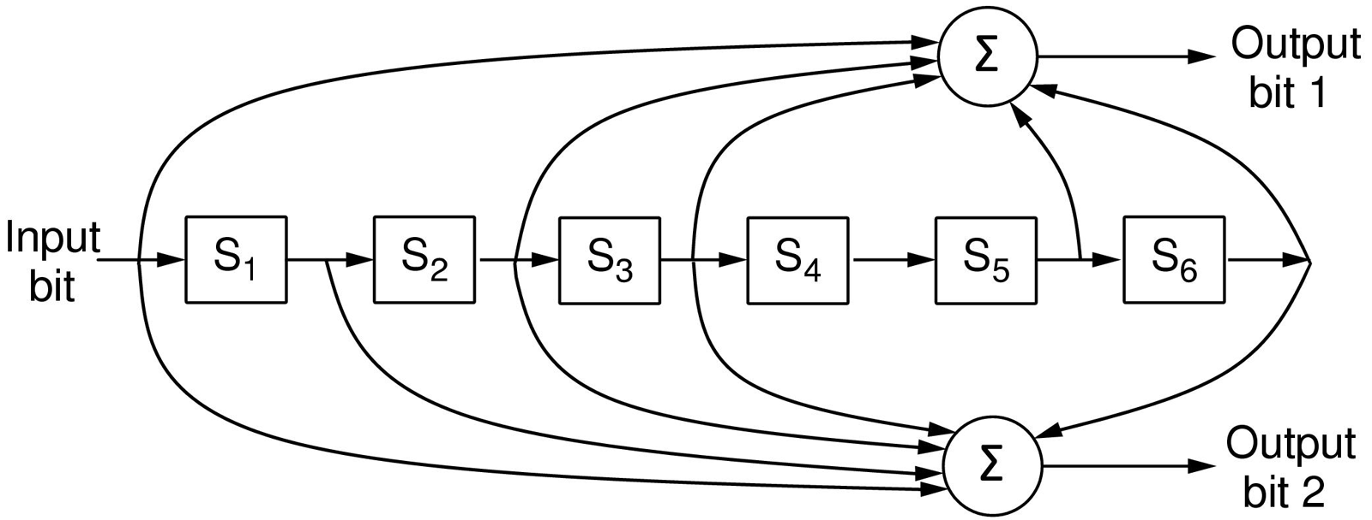
Error Detection Codes (3)
The NASA binary convolutional code used in 802.11.

Slide 53
Convolutional Encoders
Like any error-correcting code, a convolutional code works by adding some structured redundant information to the user's data and then correcting errors using this information.
A convolutional encoder is a linear system.
A binary convolutional encoder can be represented as a shift register. The outputs of the encoder are modulo 2 sums of the values in the certain register's cells. The input to the encoder is either the unencoded sequence (for non-recursive codes) or the unencoded sequence added with the values of some register's cells (for recursive codes).
Convolutional codes can be systematic and non-systematic. Systematic codes are those where an unencoded sequence is a part of the output sequence. Systematic codes are almost always recursive, conversely, non-recursive codes are almost always non-systematic.

Slide 54
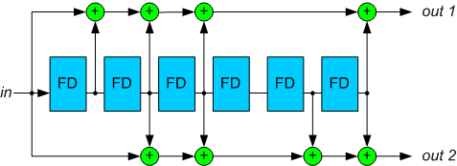
Convolutional Encoders
A combination of register's cells that forms one of the output streams (or that is added with the input stream for recursive codes) is defined by a polynomial. Let m be the maximum degree of the polynomials constituting a code, then K=m+1 is a constraint length of the code.
Figure 1. A standard NASA convolutional encoder with polynomials (171,133).

Slide 55
Convolutional Encoders
For example, for the decoder on the Figure 1, the polynomials are:
g₁(z)=1+z+z²+z³+z⁶
g₂(z)=1+z²+z³+z⁵+z⁶
A code rate is an inverse number of output polynomials.
For the sake of clarity, in this article we will restrict ourselves to the codes with rate R=1/2. Decoding procedure for other codes is similar.
Encoder polynomials are usually denoted in the octal notation. For the above example, these designations are “1111001” = 171 and “1011011” = 133.
The constraint length of this code is 7.
An example of a recursive convolutional encoder is on the Figure 2.

Slide 56
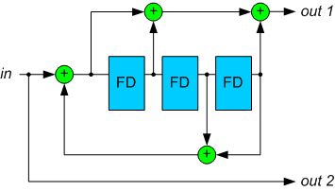
Example of the Convolutional Encoder
Figure 2. A recursive convolutional encoder.

Slide 57
Trellis Diagram
A convolutional encoder is often seen as a finite state machine. Each state corresponds to some value of the encoder's register. Given the input bit value, from a certain state the encoder can move to two other states. These state transitions constitute a diagram which is called a trellis diagram.
A trellis diagram for the code on the Figure 2 is depicted on the Figure 3. A solid line corresponds to input 0, a dotted line – to input 1 (note that encoder states are designated in such a way that the rightmost bit is the newest one).
Each path on the trellis diagram corresponds to a valid sequence from the encoder's output. Conversely, any valid sequence from the encoder's output can be represented as a path on the trellis diagram. One of the possible paths is denoted as red (as an example).

Slide 58
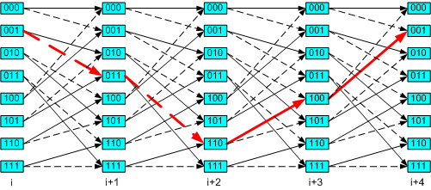
Trellis Diagram
Figure 3. A trellis diagram corresponding to the encoder on the Figure 2.

Slide 59
Trellis Diagram
Note that each state transition on the diagram corresponds to a pair of output bits. There are only two allowed transitions for every state, so there are two allowed pairs of output bits, and the two other pairs are forbidden. If an error occurs, it is very likely that the receiver will get a set of forbidden pairs, which don't constitute a path on the trellis diagram. So, the task of the decoder is to find a path on the trellis diagram which is the closest match to the received sequence.

Slide 60
Trellis Diagram
Let's define a free distance d_{f} as a minimal Hamming distance between two different allowed binary sequences (a Hamming distance is defined as a number of differing bits).
A free distance is an important property of the convolutional code. It influences a number of closely located errors the decoder is able to correct.

Slide 61
Viterbi Algorithm
Viterbi algorithm reconstructs the maximum-likelihood path for a given input sequence.

Slide 62
Error-Detecting Codes (1)
Linear, systematic block codes
Parity.
Checksums.
Cyclic Redundancy Checks (CRCs).

Slide 63
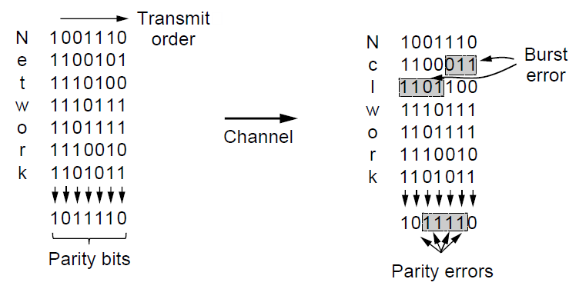
Error-Detecting Codes (2)
Interleaving of parity bits to detect a burst error.

Slide 64
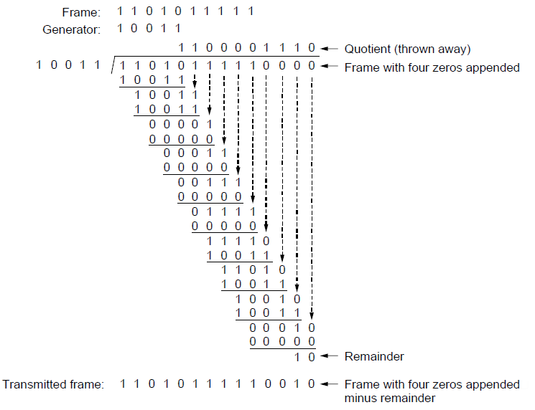
Error-Detecting Codes (3)
Example calculation of the CRC

Slide 65
Elementary Data Link Protocols (1)
Utopian Simplex Protocol
Simplex Stop-and-Wait Protocol
  Error-Free Channel
Simplex Stop-and-Wait Protocol
  Noisy Channel

Slide 66
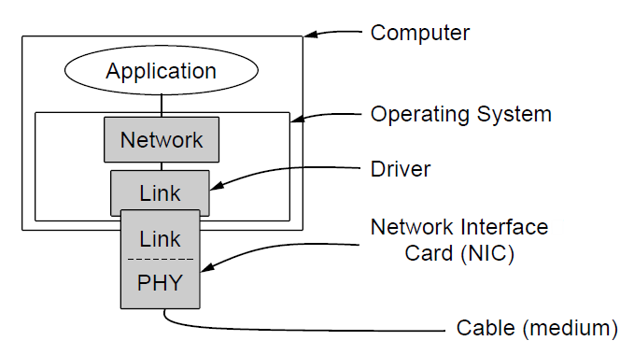
Elementary Data Link Protocols (2)
Implementation of the physical, data link, and network layers.

Slide 67
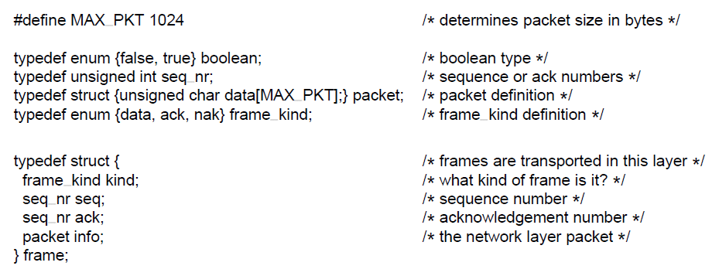
Elementary Data Link Protocols (3)
. . .
Some definitions needed in the protocols to follow. These definitions are located in the file protocol.h.

Slide 68
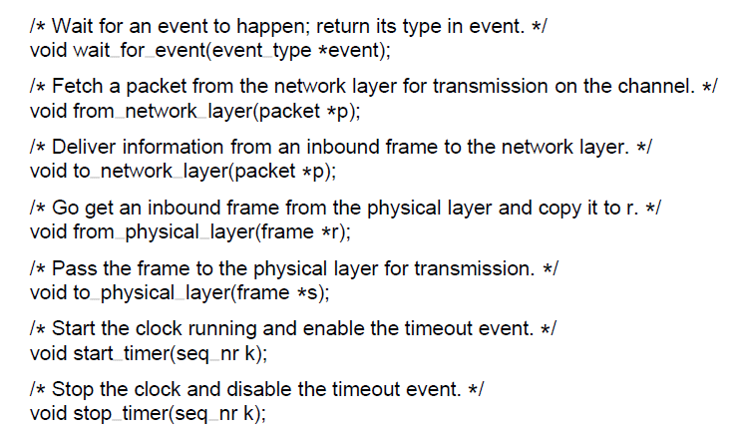
Elementary Data Link Protocols (4)
. . .
Some definitions needed in the protocols to follow. These definitions are located in the file protocol.h.

Slide 69
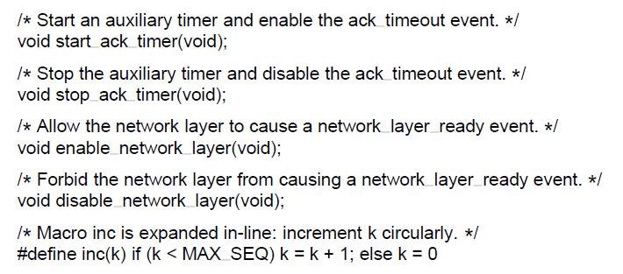
Elementary Data Link Protocols (5)
Some definitions needed in the protocols to follow. These definitions are located in the file protocol.h.

Slide 70
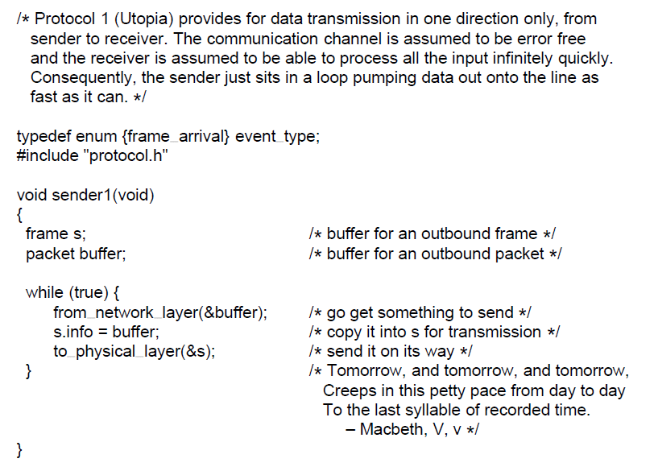
Utopian Simplex Protocol (1)
. . .
A utopian simplex protocol.

Slide 71
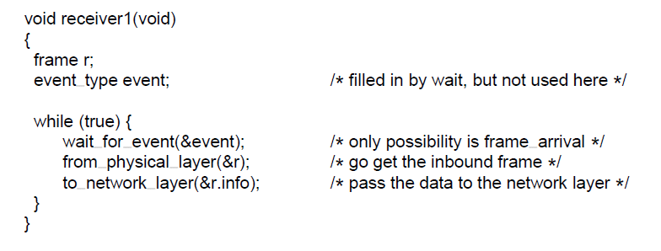
Utopian Simplex Protocol (2)
A utopian simplex protocol.

Slide 72
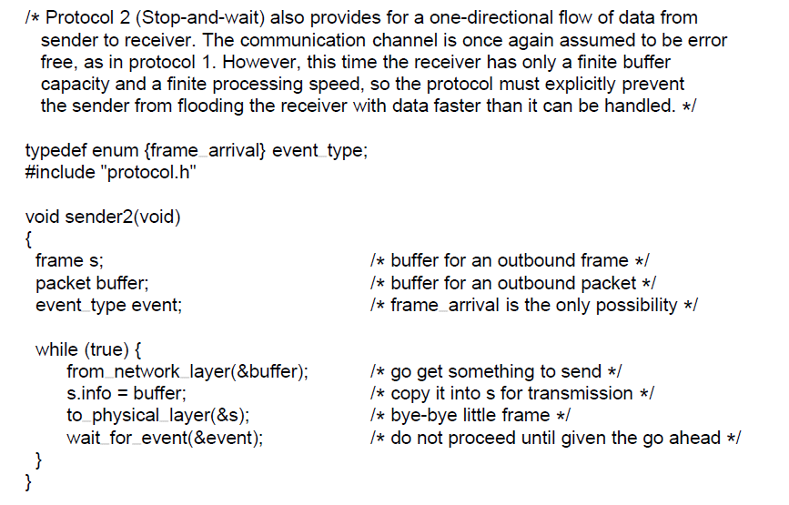
Simplex Stop-and-Wait Protocol for a Noisy Channel (1)
. . .
A simplex stop-and-wait protocol.

Slide 73
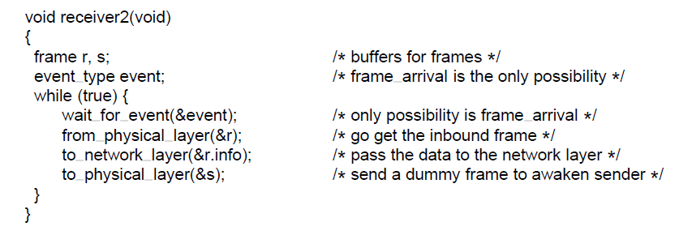
Simplex Stop-and-Wait Protocol for a Noisy Channel (2)
A simplex stop-and-wait protocol.

Slide 74
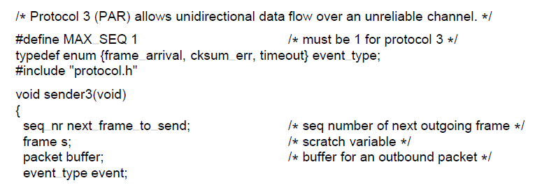
Sliding Window Protocols (1)
. . .
A positive acknowledgement with retransmission protocol.

Slide 75
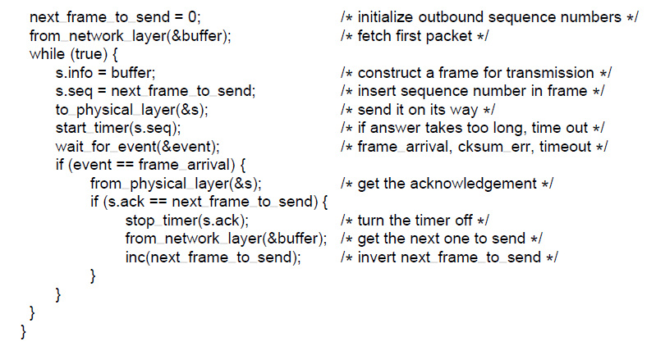
Sliding Window Protocols (2)
. . .
A positive acknowledgement with retransmission protocol.

Slide 76
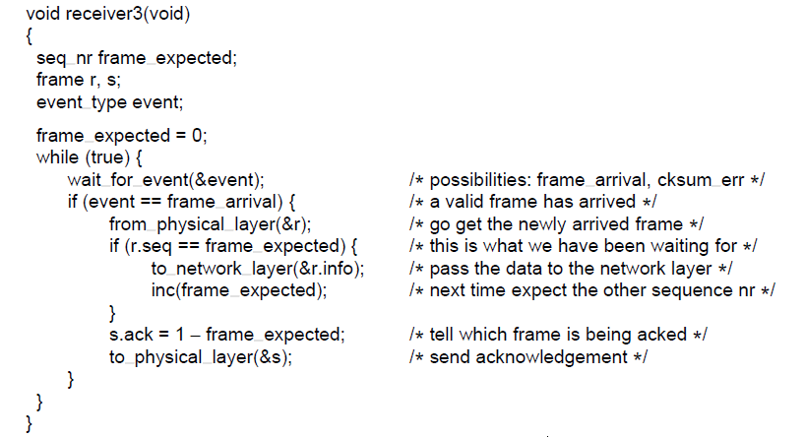
Sliding Window Protocols (3)
A positive acknowledgement with retransmission protocol.

Slide 77
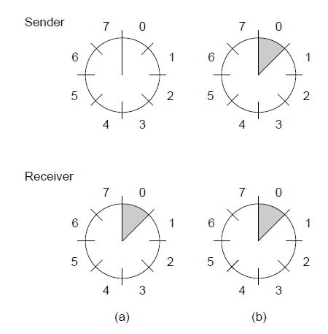
Sliding Window Protocols (4)
A sliding window of size 1, with a 3-bit sequence number.
(a) Initially. (b) After the first frame has been sent.

Slide 78
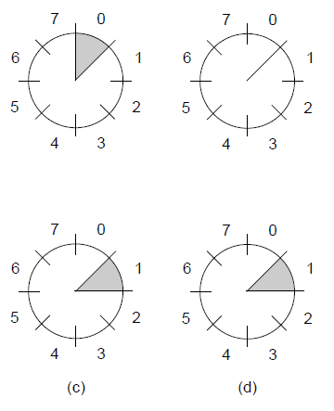


Sliding Window Protocols (5)
A sliding window of size 1, with a 3-bit sequence number
(c) After the first frame has been received. (d) After the first acknowledgement has been received.

Slide 79
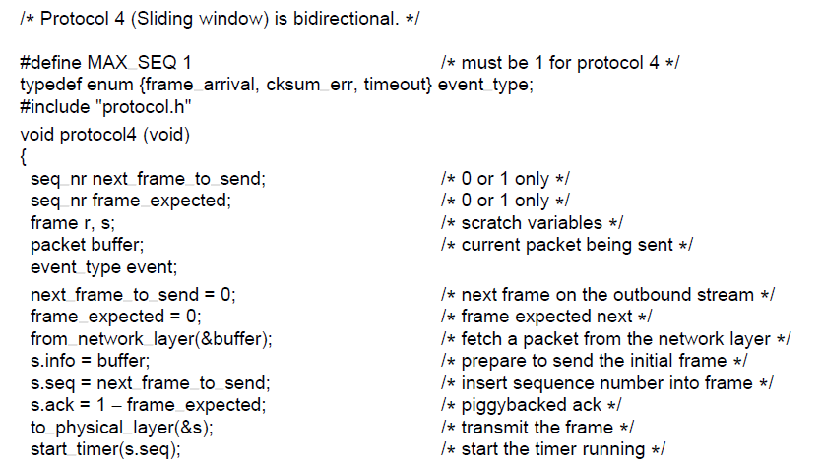
One-Bit Sliding Window Protocol (1)
. . .
A 1-bit sliding window protocol.

Slide 80
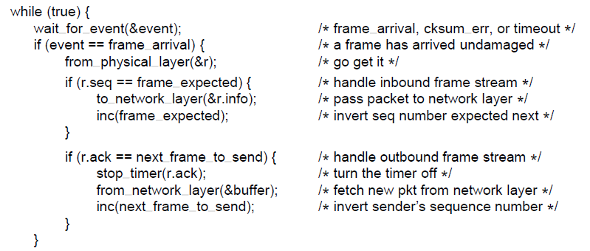
One-Bit Sliding Window Protocol (2)
. . .
A 1-bit sliding window protocol.

Slide 81
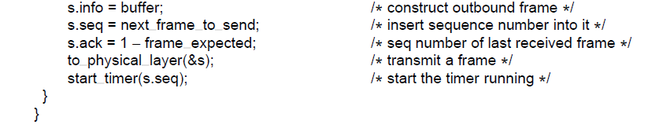
One-Bit Sliding Window Protocol (3)
A 1-bit sliding window protocol.

Slide 82
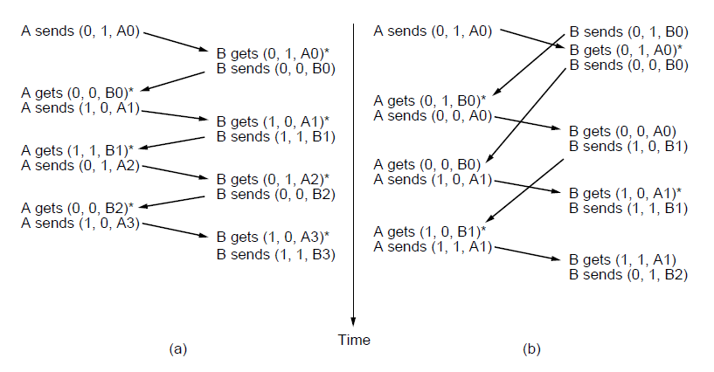
One-Bit Sliding Window Protocol (4)
Two scenarios for protocol 4. (a) Normal case. (b) Abnormal
case. The notation is (seq, ack, packet number). An asterisk indicates where a network layer accepts a packet

Slide 83
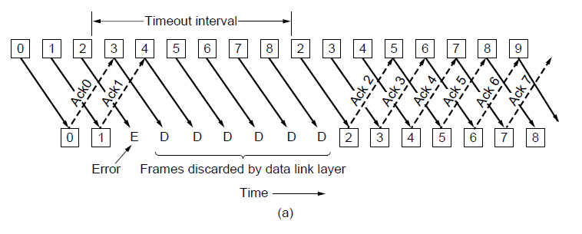
Protocol Using Go-Back-N (1)
Pipelining and error recovery. Effect of an error when
(a) receiver’s window size is 1

Slide 84
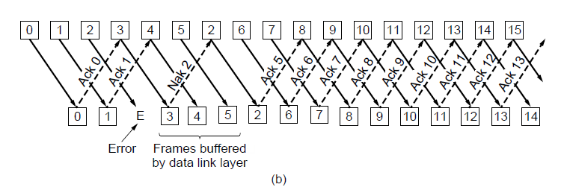
Protocol Using Go-Back-N (2)
Pipelining and error recovery. Effect of an error when
(b) receiver’s window size is large.

Slide 85
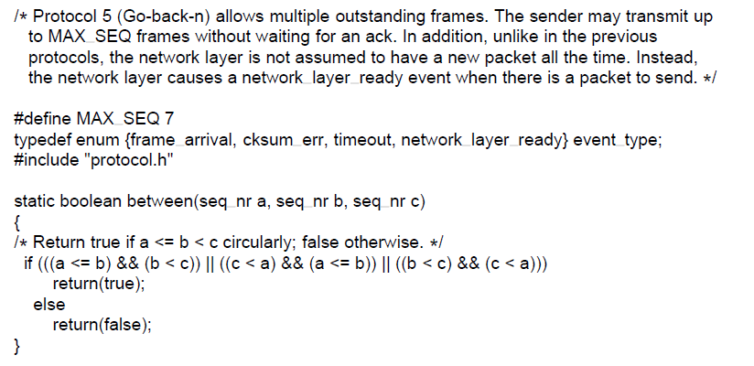
Protocol Using Go-Back-N (3)
. . .
A sliding window protocol using go-back-n.

Slide 86
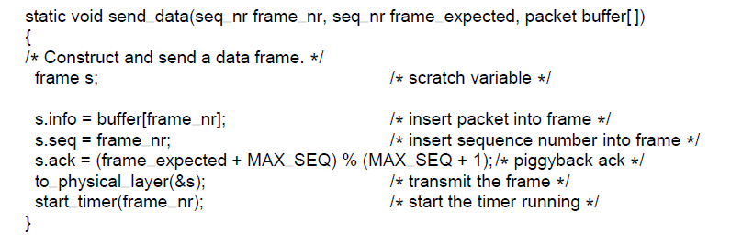
Protocol Using Go-Back-N (4)
. . .
A sliding window protocol using go-back-n.

Slide 87
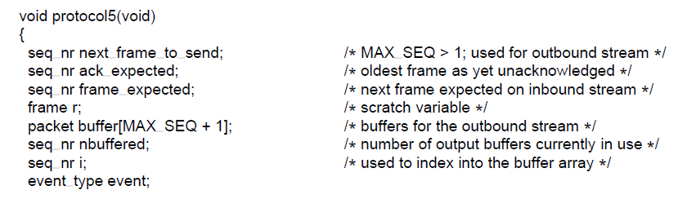
Protocol Using Go-Back-N (5)
. . .
A sliding window protocol using go-back-n.

Slide 88
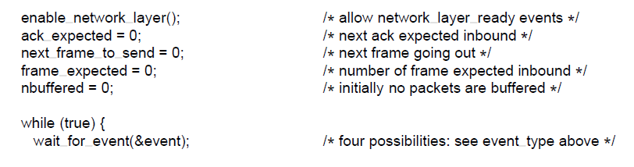
Protocol Using Go-Back-N (6)
. . .
A sliding window protocol using go-back-n.

Slide 89
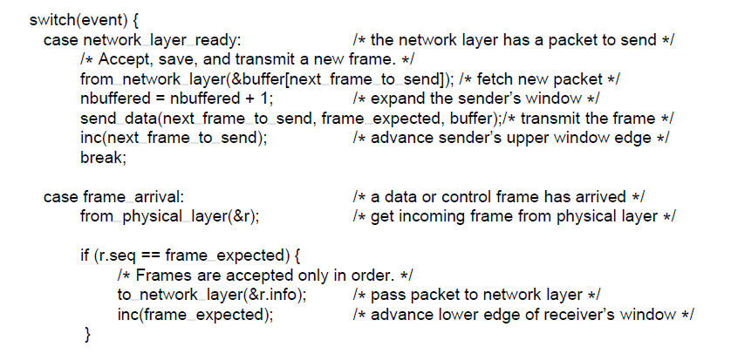
Protocol Using Go-Back-N (7)
. . .
A sliding window protocol using go-back-n.

Slide 90
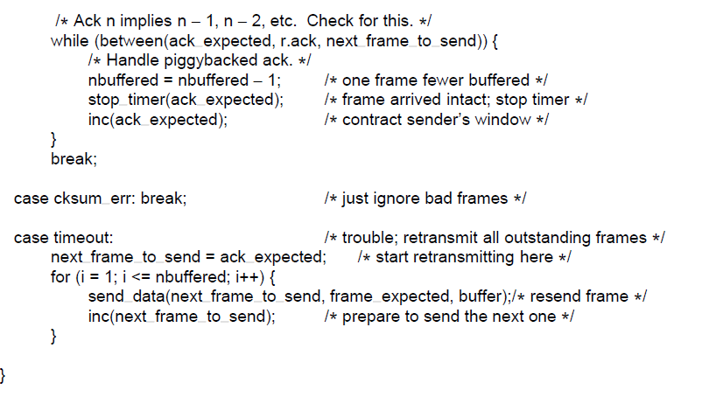
Protocol Using Go-Back-N (8)
. . .
A sliding window protocol using go-back-n.

Slide 91
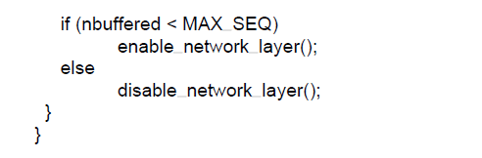
Protocol Using Go-Back-N (9)
A sliding window protocol using go-back-n.

Slide 92
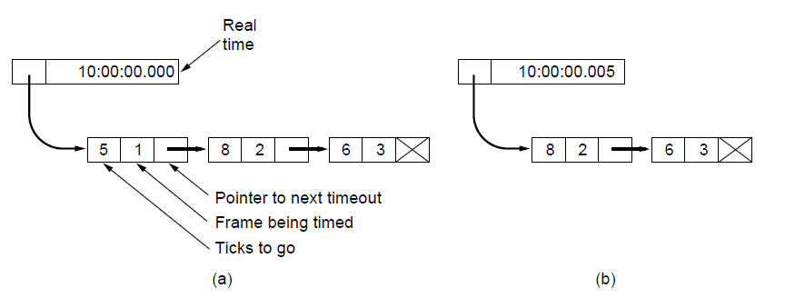
Protocol Using Go-Back-N (10)
Simulation of multiple timers in software. (a) The queued
timeouts (b) The situation after the first timeout has expired.

Slide 93
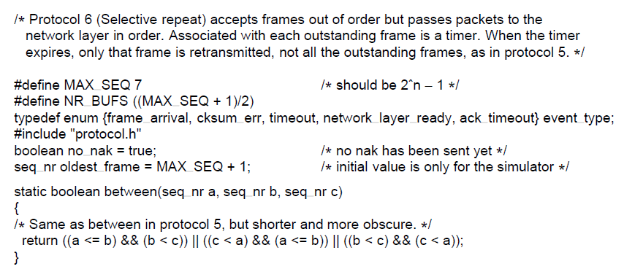
Protocol Using Selective Repeat (1)
. . .
A sliding window protocol using selective repeat.

Slide 94
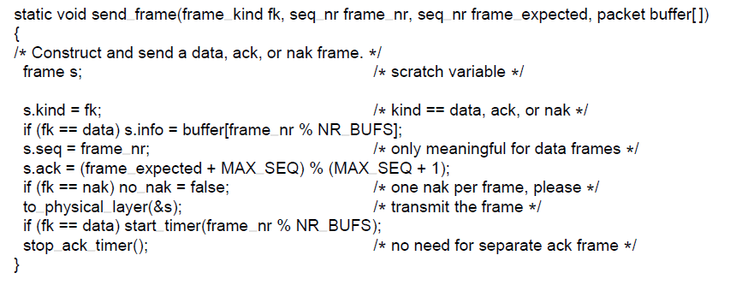
Protocol Using Selective Repeat (2)
. . .
A sliding window protocol using selective repeat.

Slide 95
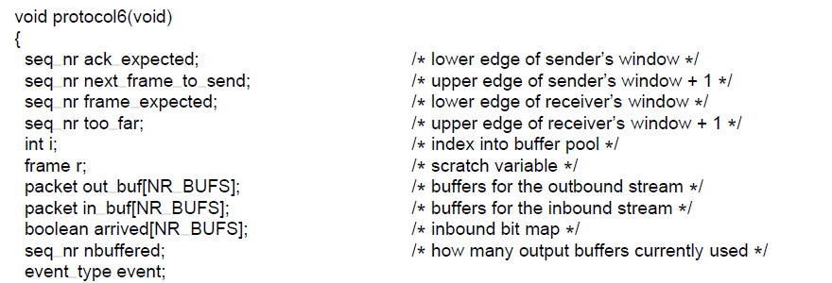
Protocol Using Selective Repeat (3)
. . .
A sliding window protocol using selective repeat.

Slide 96
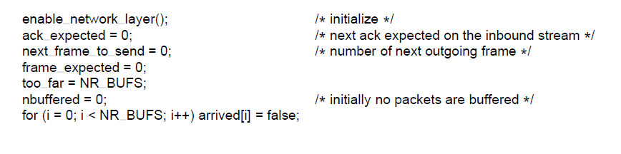
Protocol Using Selective Repeat (4)
. . .
A sliding window protocol using selective repeat.

Slide 97
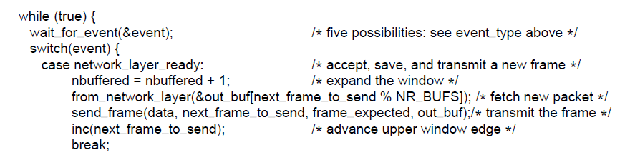
Protocol Using Selective Repeat (5)
. . .
A sliding window protocol using selective repeat.

Slide 98
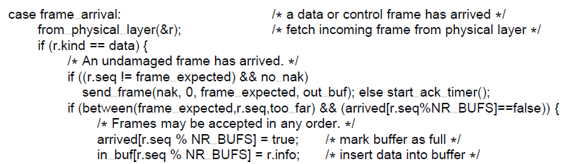
Protocol Using Selective Repeat (6)
. . .
A sliding window protocol using selective repeat.

Slide 99
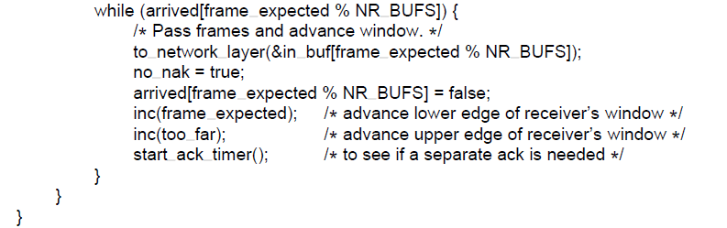
Protocol Using Selective Repeat (7)
. . .
A sliding window protocol using selective repeat.

Slide 100
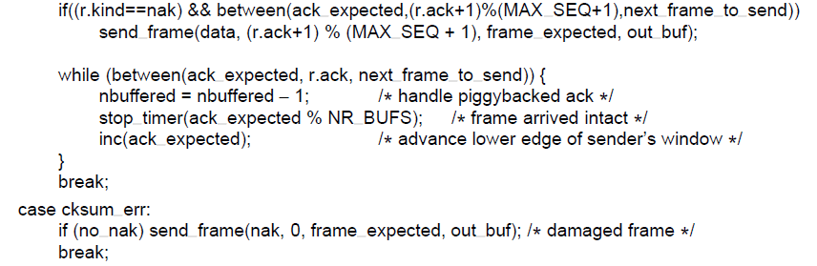
Protocol Using Selective Repeat (8)
. . .
A sliding window protocol using selective repeat.

Slide 101
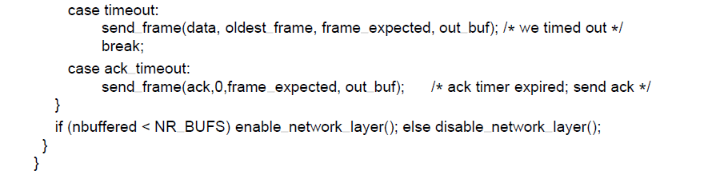
Protocol Using Selective Repeat (9)
A sliding window protocol using selective repeat.

Slide 102

Protocol Using Selective Repeat (10)
Initial situation with a window of size7
After 7 frames sent and received but not acknowledged.
Initial situation with a window size of 4.
After 4 frames sent and received but not acknowledged.

Slide 103
Example Data Link Protocols
Packet over SONET
ADSL (Asymmetric Digital Subscriber Loop)

Slide 104

Packet over SONET (1)
Packet over SONET. (a) A protocol stack. (b) Frame relationships

Slide 105
Packet over SONET (2)
PPP Features
Separate packets, error detection
Link Control Protocol
Network Control Protocol

Slide 106

Packet over SONET (3)
The PPP full frame format for unnumbered mode operation

Slide 107

Packet over SONET (4)
State diagram for bringing a PPP link up and down

Slide 108

ADSL (Asymmetric Digital
Subscriber Loop) (1)
ADSL protocol stacks.

Slide 109

ADSL (Asymmetric Digital
Subscriber Loop) (1)
AAL5 frame carrying PPP data

Slide 110
End
Chapter 3

